Slide 1
San Francisco Crime Classification
CIS/SCM – 593, Cohort C - Team 01

Slide 2
Agenda
Problem Overview
Background
Understanding the Data
Approach – Old & New
Feature Engineering
Evaluation Metrics
Kaggle Result
Conclusion
Interactive Visualizations

Slide 3
Problem Overview
Our goal is to predict crime category of the past crime recordings.
Given the time and location of crime occurred.
Understanding the data through visualization.
Map patterns and trends in the crime data.
Such studies are representative of efforts by many police forces today.
Using machine learning approaches, one can get an improved understanding of which crimes occur where and when in a city.

Slide 4
Dynamic allocation of Police Forces
http://www.forbes.com/sites/emc/2014/06/03/data-analysis-helps-police-departments-fight-crime/#5ca6e3e243e8
Smart Policing Initiative (SPI) - collaboration between the federal Bureau of Justice Assistance and the non-profit CNA Corporation.
Data-centered crime prevention programs in 38 local police departments.
Hotspot policing - practice of analyzing crime data for geographic patterns to identify crime “hotspots”. [1995]
Smart Policing: Police-officers-turned-analysts. Example – Philadelphia.
http://technical.ly/philly/2014/02/18/philadelphia-police-smart-policing-crime-scientists/

Slide 5
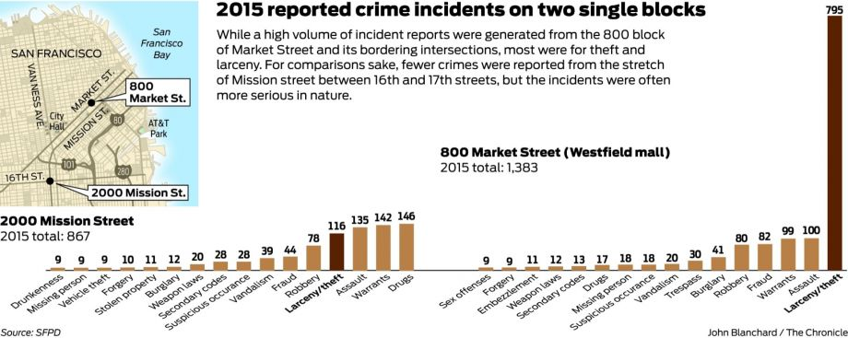
Crimes in San Francisco
http://www.sfchronicle.com/crime/article/Dubious-distinction-S-F-s-most-crime-ridden-6767550.php

Slide 6
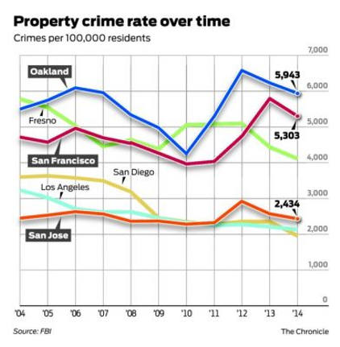
Crime Trends in San Francisco
Continuing drop in Property crime.
8.5 percent drop in 2014.
Skyrocketing burglaries and thefts.
Auto burglary task force to go after serial offenders.
2014 vs 2013: The city had nearly 1,000 fewer robberies than in 2013 and about 500 fewer assaults.
http://www.sfchronicle.com/crime/article/U-S-crime-drops-again-but-gains-uneven-in-Bay-6536129.php

Slide 7
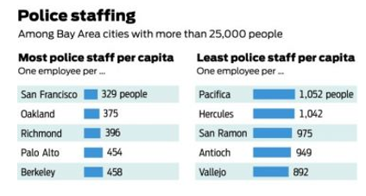
Struggling with Police Staffing
Recession -> blow to the city funding.
Staffing levels are down from a decade ago.
2004 to 2014: City’s population grew 12 percent.
2004 to 2014: The number of sworn officers dropped 3 percent.
Notes:
“The most significant thing that happened to crime control was the recession,” Weisberg said. “It was a horribly serious blow to county and city funding.”
The FBI report shows that although San Francisco maintained a bigger police force per capita than any other Bay Area community, staffing levels are down from a decade ago.
A recent study found that as the city’s population grew 12 percent between 2004 and 2014, the number of sworn officers dropped 3 percent.
San Francisco leaders, like those in other communities including San Jose and Vallejo, are pushing to bring their police ranks back to historically high levels.

Slide 8
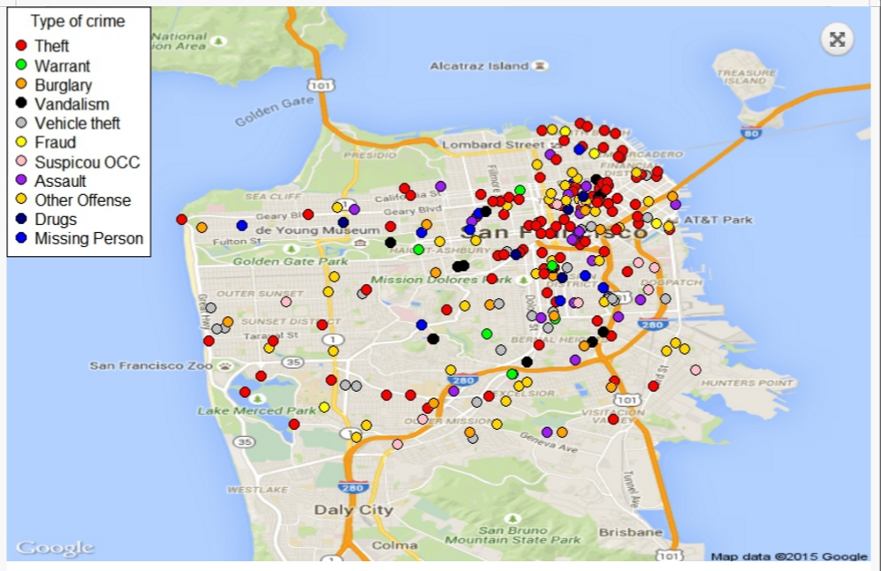
Weather Condition & Type of Crime
https://nycdatascience.com/correlation-between-weather-condition-and-the-type-of-crime/
Notes:
Tenderloin (area in AT&T park) is infamous for highest crime in the city of San Francisco but not all crime are the same. Theft crime is mostly occurs at this region but other type of crime are even distributed among San Francisco.

Slide 9
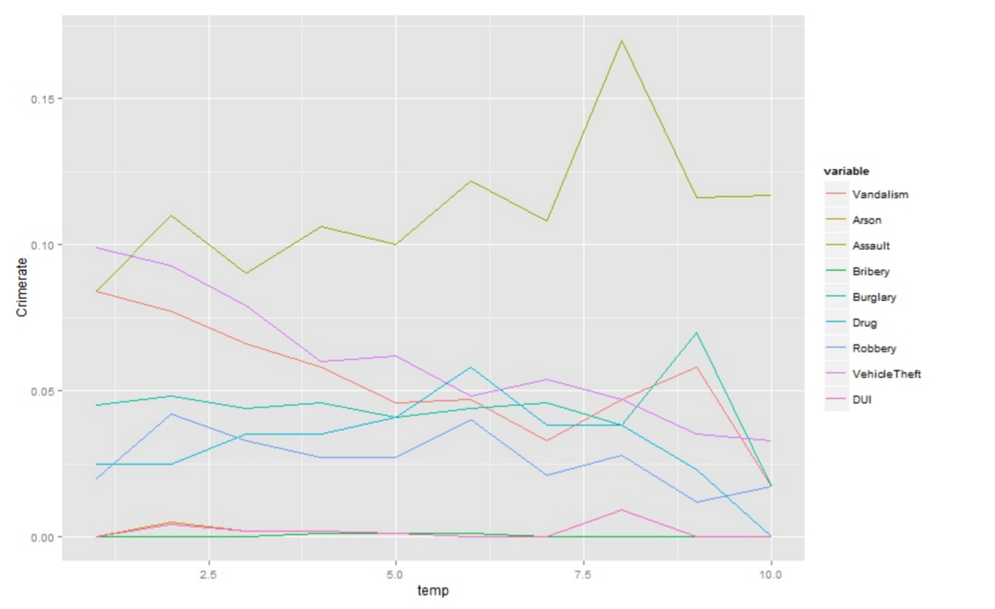
Temperature vs Crime Rate
Notes:
From this chart, we can see temperature has negative correlation with the crime. Most criminal prefer to do the crime at cooler temperature than hot day. However, assault rate is higher at hot temperature than cooler temperature. As expected, bribery and DUI has no influence by the change of temperature.

Slide 10
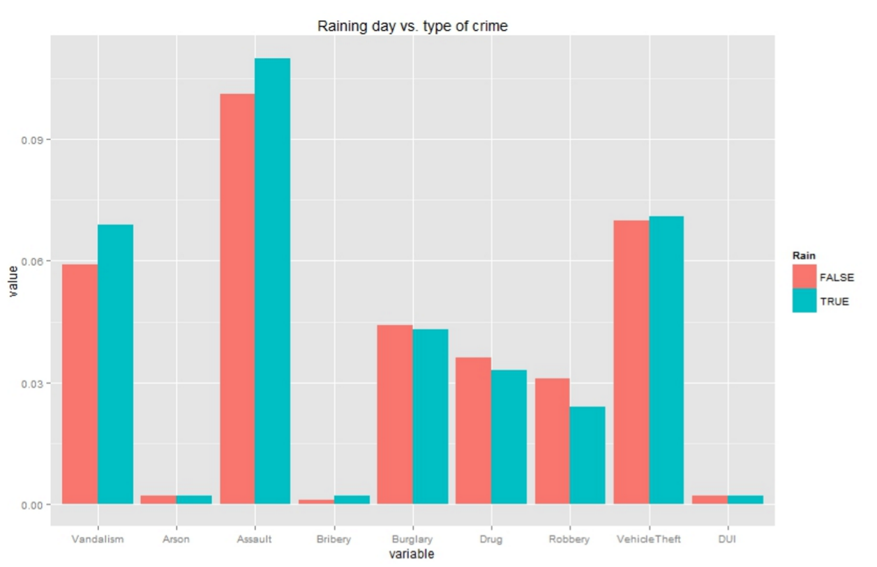
Precipitation vs Type of Crime
Notes:
Most crime has no significant difference between raining day and sunny day. It is interesting to note more assault and vandalism occurred on raining day than non raining day. As expected, bribery, DUI and Drugs related crime does not depend on raining condition. Most Robbery occurred during non raining day.

Slide 11
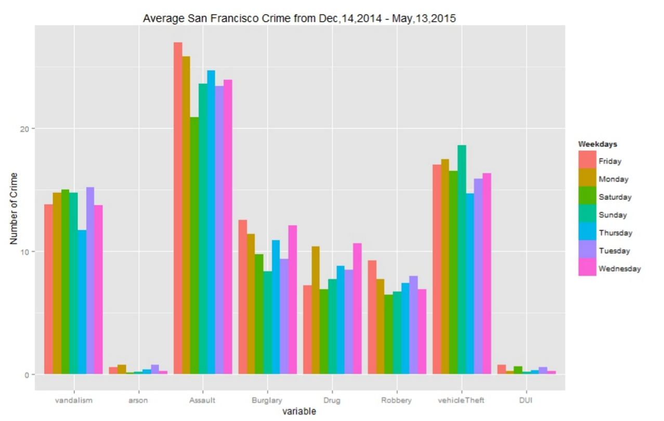
Crime Trend on Weekdays
Notes:
Interestingly, we see that the average rate of crime are different per weekday. Assault rate is highest on Friday but dropped significantly on Saturday. Burglary is highest on Friday and Wednesday but low on Sunday. Robbery is highest among the week. Vehicle theft like to steal car on Friday. As expected, DUI is higher on Friday and Saturday.

Slide 12
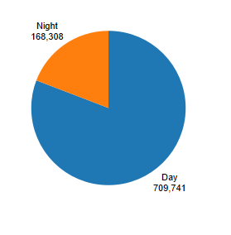
Night vs Day Crime Rate (Night – 10pm to 6am)

Slide 13
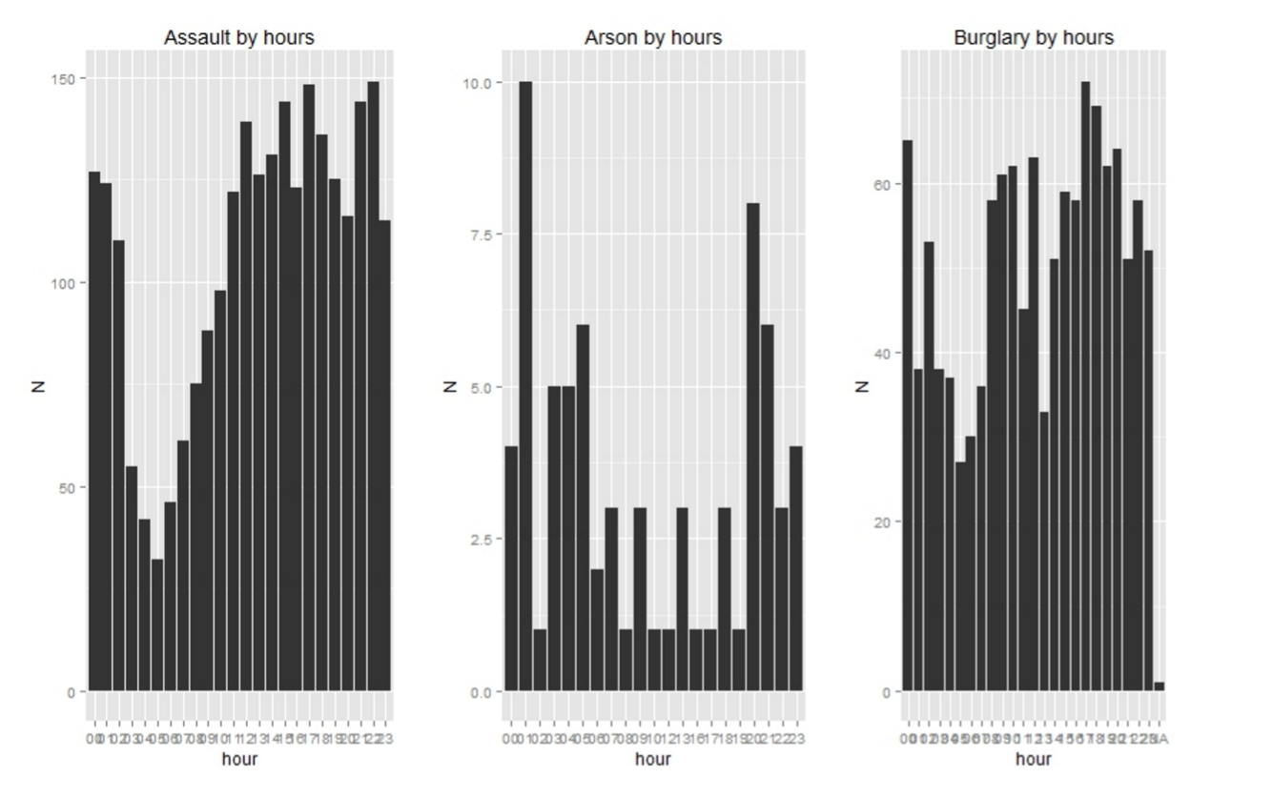
Crime Type breakdown by Hours (Assault, Arson, Burglary)

Slide 14
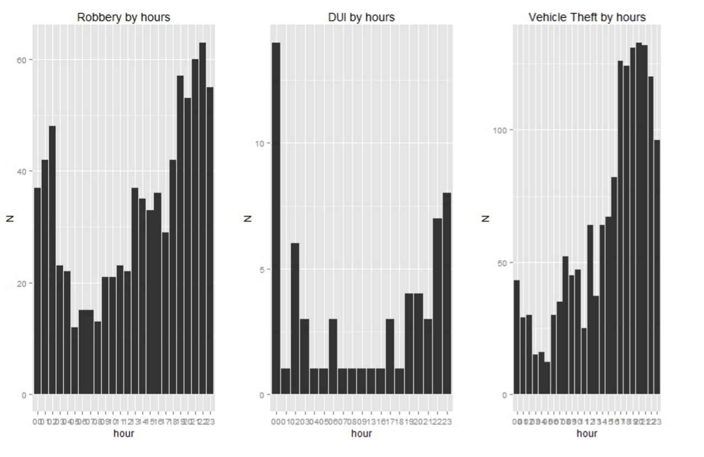
Crime Type breakdown by Hours (Robbery, DUI, Vehicle Theft)

Slide 15
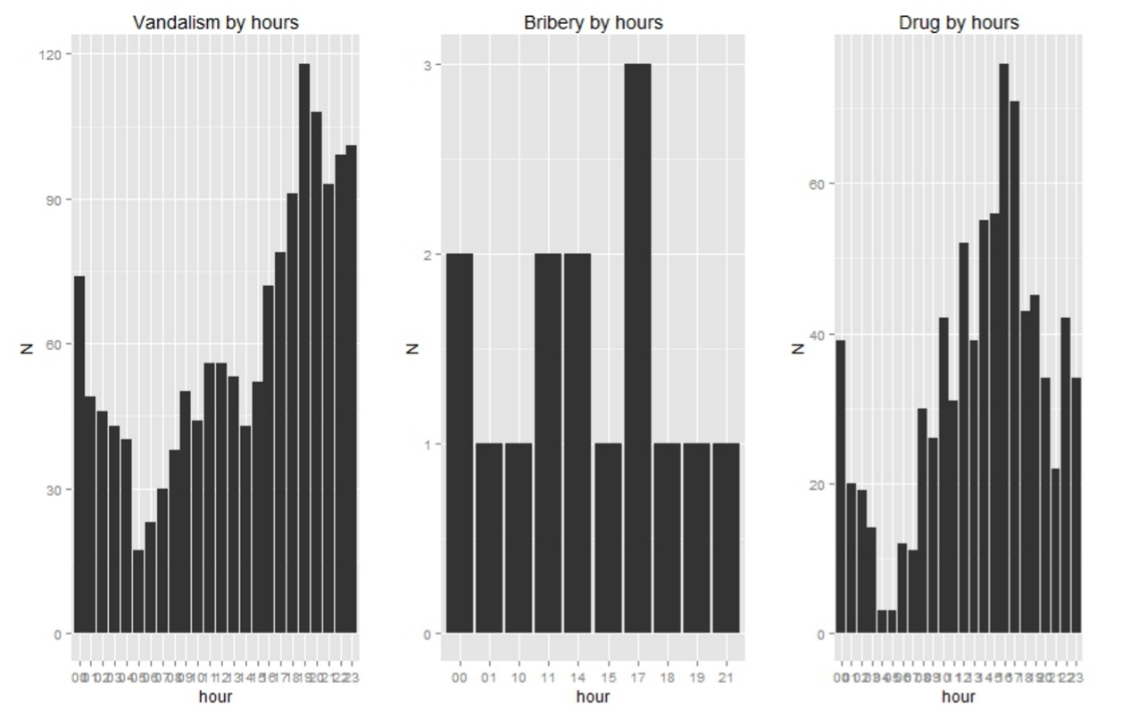
Crime Type breakdown by Hours (Vandalism, Bribery, Drug)
Notes:
Criminal are most active at night time from 4pm to 12 am and lowest at 3-6 am. Most interestingly to note highest drug related arrested at around 4pm. DUI related arrested is mostly around 11pm to 12 am.

Slide 16
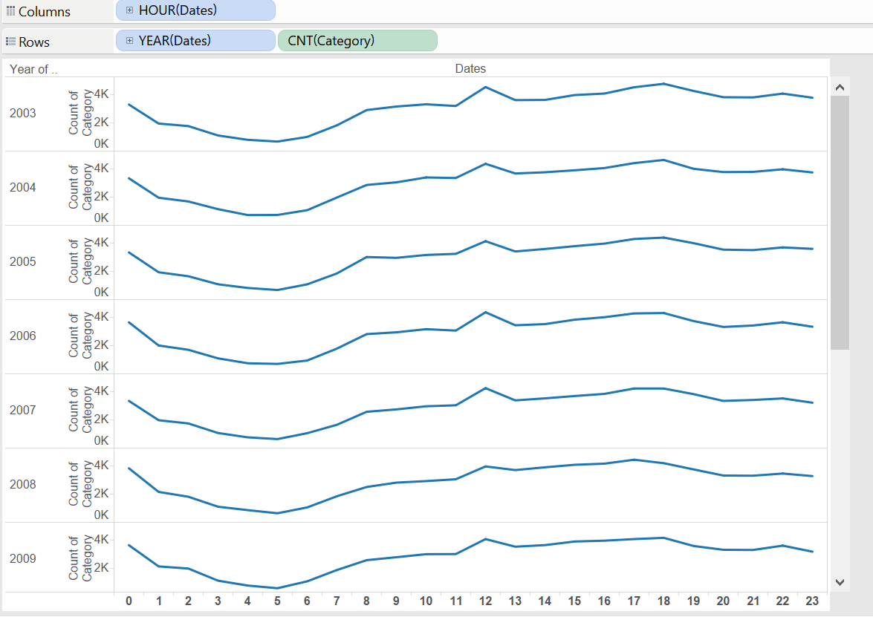
Crime Trend by Hours over Years

Slide 17
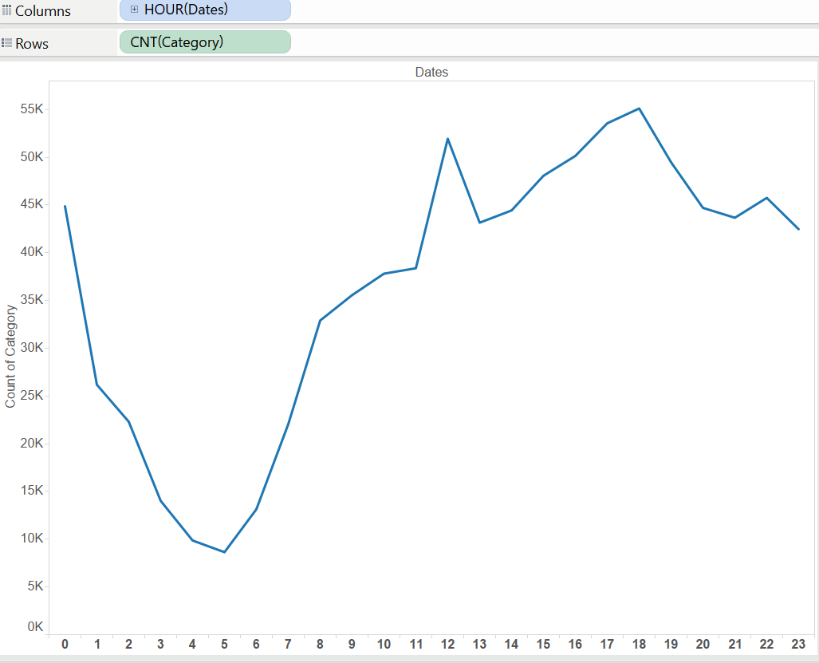
6 New Variables for Hourly Trend
Steep Peak – 5 to 8: Early Morning
Slow Peak – 8 to 12: Morning
Short Dip – 12 to 13: Noon
Slow Peak – 13 to 18: Early Evening
Slow Dip – 18 to 22: Late Evening
Sharp Dip – 22 to 5: Night

Slide 18
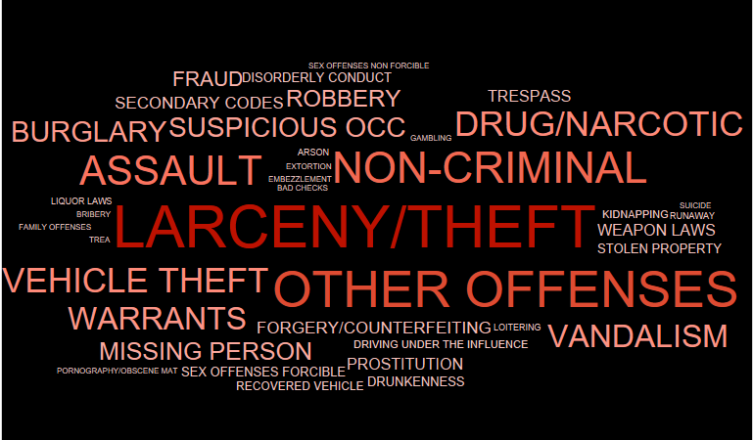
Visualization – Crime Word Cloud

Slide 19
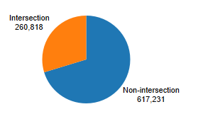
Visualization – Intersection

Slide 20
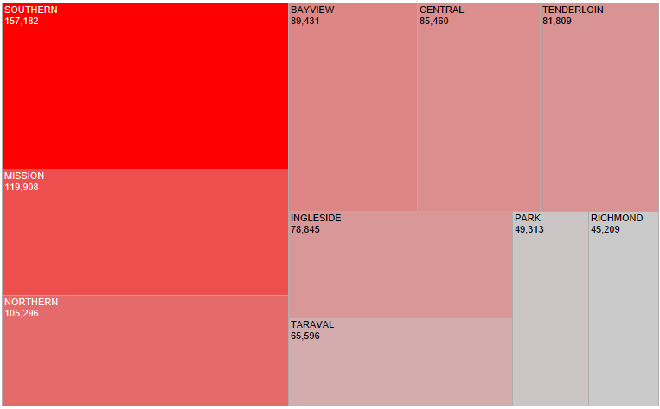
Visualization – PD District

Slide 21
Approach – Old
Problem Type : Multi-class classification
Approach: Reduce to multiple binary classifiers
Tools used – R, Tableau
New variables:
Split ‘Dates’ -> Day, Month, Year, Hour, Minutes, Seconds
Intersection – 1 at addresses with intersections
Night – 1 between 10 pm to 6 am
Week – 1 on weekdays else 0
Algorithms:
Glm()
Glmnet()

Slide 22
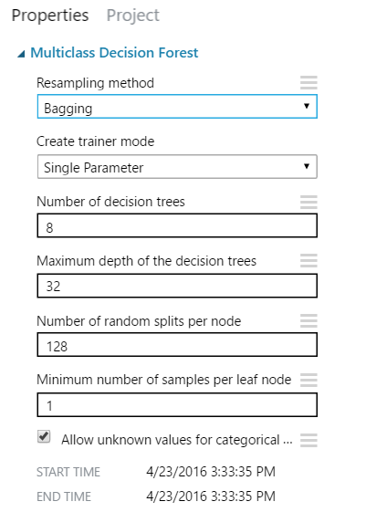
Approach – New
Problem Type : Multi-class classification
Tools used – R, Tableau , Azure ML
New variables:
Hourly breakdown – 6 variables
Algorithms:
Decision Forest
Decision Jungle
Logistic Regression

Slide 23
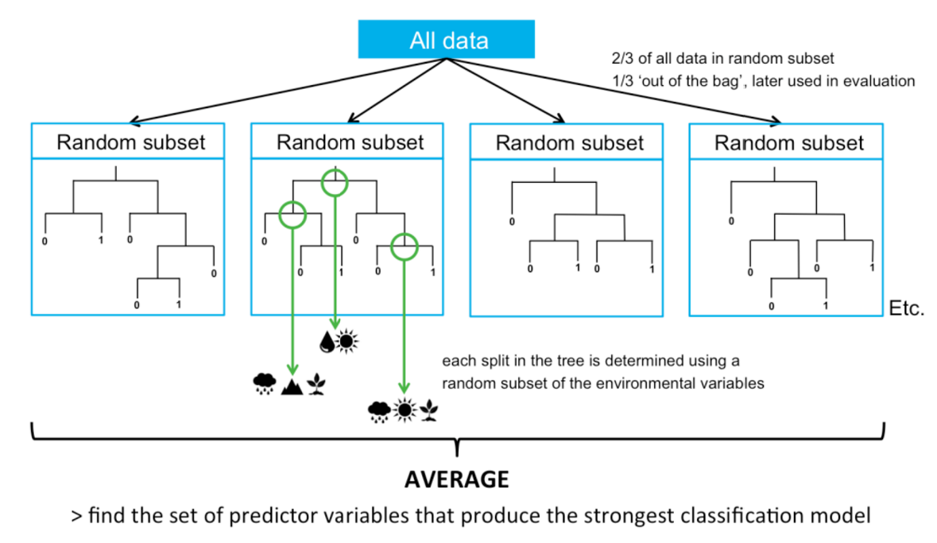
Random Forest

Slide 24
6 New Variables for Hourly Trend
Steep Peak – 5 to 8: Early Morning
Slow Peak – 8 to 12: Morning
Short Dip – 12 to 13: Noon
Slow Peak – 13 to 18: Early Evening
Slow Dip – 18 to 22: Late Evening
Sharp Dip – 22 to 5: Night

Slide 25
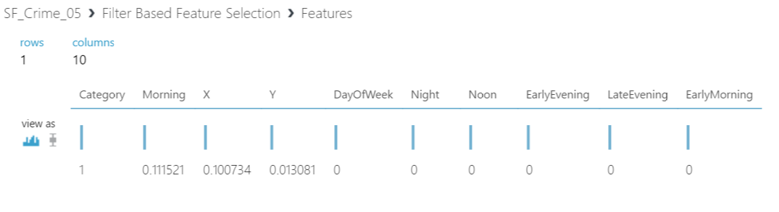
Feature Engineering

Slide 26
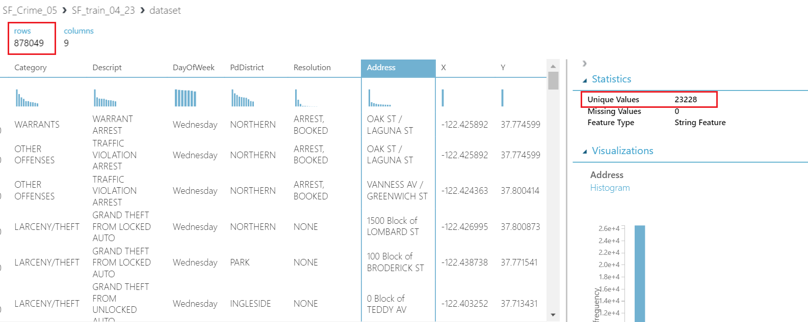
Address Variable

Slide 27
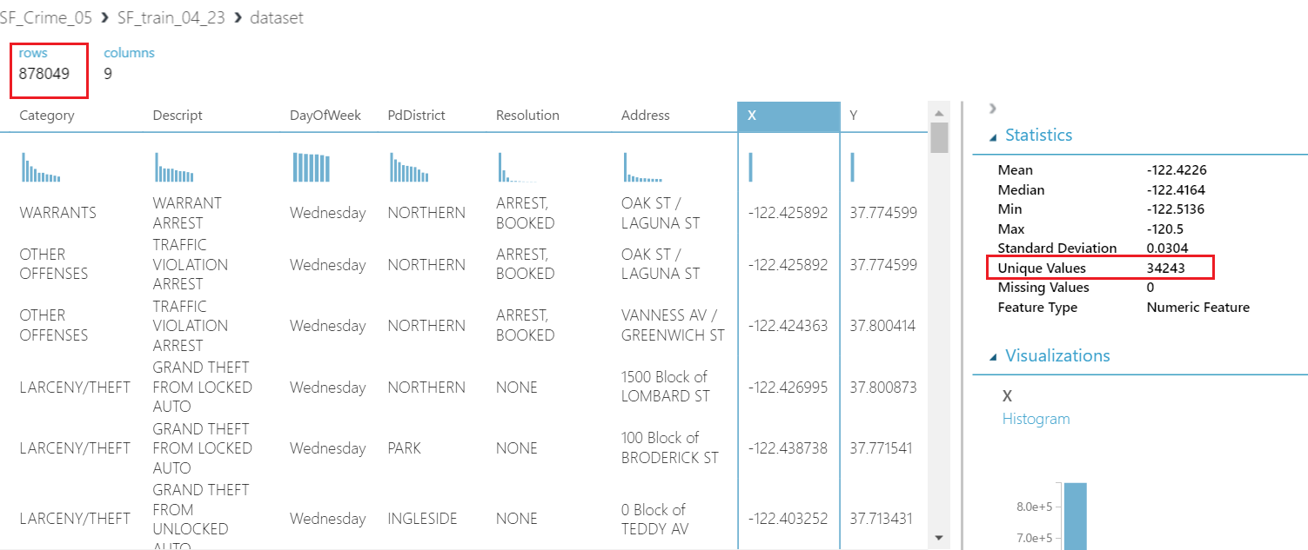
More unique X,Y Coordinates

Slide 28
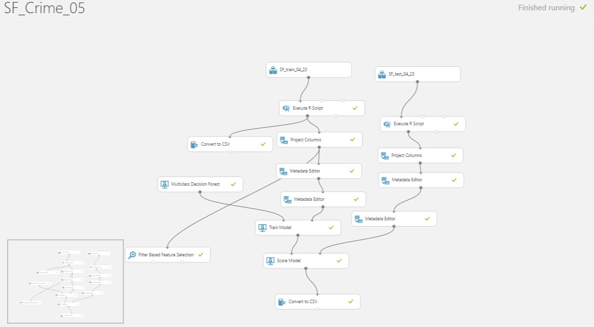
AZURE ML Model

Slide 29
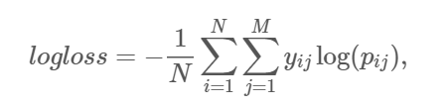
Multi-Class Logarithmic Loss
where
N is the number of cases in the test set,
M is the number of class labels,
\\(log\\) is the natural logarithm,
\\(y_{ij}\\) is 1 if observation \\(i\\) is in class \\(j\\) and 0 otherwise, and
\\(p_{ij}\\) is the predicted probability that observation \\(i\\) belongs to class \\(j\\).

Slide 30
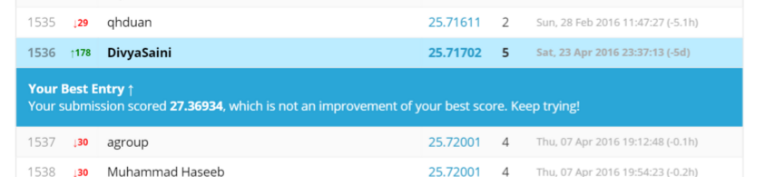
Kaggle Results
Best – 25.7
Started with – 31.08

Slide 31
Conclusion
After Interim
Multi-Class Classification
Azure ML + R + Tableau
Before Interim
Multiple Binary Classifiers
R + Tableau
Data driven variables
Intuitive Variables
Weather Data
Intersection Variable
Weekend Variable
Hourly Trend

Slide 32
Interactive Visualizations
https://public.tableau.com/profile/shaikh.shiban.qureshi#!/

Slide 33
Thank You.
Ashfaqul Haq, David Dorfman, Divya Saini, Shaikh Shiban Qureshi

